Slide 1

HOW TO RUN A SUCCESSFUL
STUDENT GROUP
University of Maryland School of Medicine
2025-2026 Academic Year

Slide 2
Key Contacts
Student Council (umb.som.council@gmail.com)
OSA
  Kerri Thom, Associate Dean for Student Affairs (kthom@som.umaryland.edu)
  Adam Esselman, Senior Academic Services Specialist (aesselman@som.umaryland.edu)

Slide 3
Leadership Expectations and Policies

Slide 4
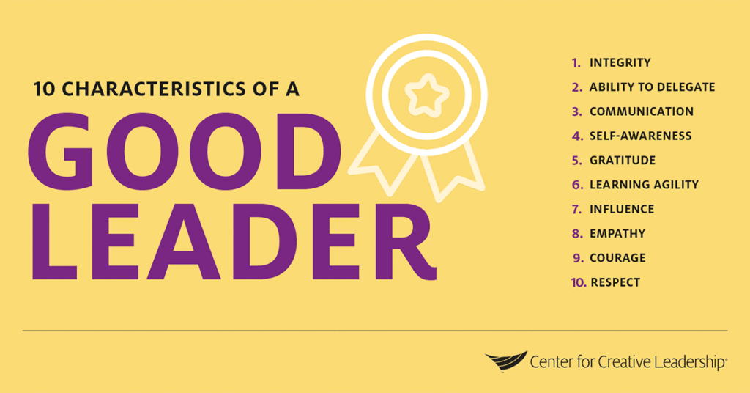
11. Knowledge
12. Organization
13. Reliability
14. Problem Solving
15. Professionalism
15

Slide 5

Honing your leadership skills
1. Engage in honest, open communication
2. Connect with your team members
3. Encourage personal and professional growth
4. Keep a positive attitude
5. Teach instead of giving orders
6. Set clear goals and expectations
7. Give direct feedback about performance
8. Ask for feedback on your leadership
9. Be open to new ideas
10. Understand your own motivation
BuisnessNewsDaily.com

Slide 6
SOM Student Organizations
Student run organizations and activities which match the University's mission, vision and core values
Open to all SOM students without bias and regardless of race, creed, ability, sexual orientation, age, and gender
Must adhere to policies and procedures in the Student Handbook and the SGA constitution

Slide 7
UMB’s Core Values
Respect and Integrity
Well-Being and Sustainability
Equity and Justice
Innovation and Discovery
How to infuse core values into decision making
“At the University of Maryland, Baltimore, our core values demonstrate what we stand for and serve as a guide to how we behave. By acting on our core values, using them to guide our everyday interactions, we make UMB a place where everyone feels welcome, has a sense of belonging, and is supported to succeed.”
— President Bruce E. Jarrell, MD, FACS

Slide 8
Respect and Integrity
We value each other and hold ourselves accountable for acting ethically and transparently using compassion and empathy.
How to Be a Catalyst for Respect and Integrity
Promote open communication: Be honest and transparent with others, speak with sincerity and act with compassion, and learn and practice good listening skills.
Act ethically: Adhere to the highest standards of professional and personal responsibility, even when no one is looking.
Show empathy: Demonstrate consideration and compassion for people, help those in need, and act with patience and flexibility especially when unexpected circumstances arise.
Be accountable: Accept responsibility for your actions — good and bad — be reliable and trustworthy, and follow up and follow through on your commitments.

Slide 9
Well-Being and Sustainability
We care about the welfare of our people, planet, communities, and University.
How to Be a Catalyst for Well-Being and Sustainability
Support work-life harmony: Show grace, empathy, and be respectful of others’ workload, allow downtime for yourself and others to refresh and recharge, and make decisions consistent with a healthy quality-of-life philosophy.
Promote healthy behaviors: Practice and encourage activities that foster emotional, financial, mental, physical, and social wellness.
Protect the environment: Consider the immediate environmental impact of your decisions and actions and evaluate the future effects on the habitat.
Use resources responsibly: Encourage conservation and recycling, explore and implement efficient ways to reduce waste, and familiarize yourself with the four pillars of sustainability — social, human, economic, and environmental.
Plan for the future: Incorporate long-term considerations — regarding mission, finances, or other factors — into decision-making.

Slide 10
Equity and Justice
We embrace and are committed to diversity, and we value inclusive and just communities. We oppose racism and oppression in all their forms.
How to Be a Catalyst for Equity and Justice
Prioritize and integrate equity: Understand equity and its fundamental role to the University’s culture, promote a culture where all belong, and demonstrate and support equitable practices in the classroom and the workplace at all times.
Seek to listen and learn: Explore one’s own identity and implicit and explicit biases, and provide space to learn about different experiences, backgrounds, and how others might have encountered and overcome systemic barriers based on race, sex, ethnicity, disability, gender, gender identity, socioeconomic status, and/or other dimensions of their identities.
Create inclusive environments: Respect one another as colleagues across power differentials, use inclusive language, commit to anti-racist and anti-oppression practices, and welcome others to contribute ideas and perspectives.
Say and do something: Speak up when you recognize inequity or injustice, particularly if in a position of authority, and take action to address it, such as identifying and correcting policies and practices.
Invest in justice: Provide opportunities for University stakeholders from historically marginalized populations to guide and contribute to institutional efforts that influence and address issues of equity and inclusion, and create opportunities for persons from historically marginalized communities to serve as UMB leaders.

Slide 11
Innovation and Discovery
We imagine and explore new and improved ways to accomplish our mission through education, research, clinical care, and service.
How to Be a Catalyst for Innovation and Discovery
Promote ingenuity: Encourage thinking that challenges constraints and inertia, and imagine what is possible by exploring opportunities through creative ideas and collective talents.
Commit to continuous improvement: Learn from your failures or mistakes and be open to adopting new or changing knowledge, approaches, and ideas to influence positive outcomes.
Support informed courage: Create a culture in which taking thoughtful risks and proposing or pursuing bold ideas is encouraged and expected.
Bolster collaboration: Support interdisciplinary and multidisciplinary teamwork and the sharing of knowledge, leverage insights from others, and promote broad, interinstitutional community input and practice.
Celebrate impactful results: Measure and recognize the effectiveness of new ideas and publicize successes to internal and external audiences.

Slide 12

Stewards of UMB/SOM Mission
OUR MISSION
To improve the human condition and serve the public good of Maryland and society at-large through education, research, clinical care, and service.
Please familiarize yourself with the policy on professionalism, including professional conduct evaluations and commendations, which can be found in the academic handbook on the Office of Student Affairs website: https://www.medschool.umaryland.edu/osa/handbook/School-Policies/Professionalism/

Slide 13
TIPS for working with faculty advisors
Set some expectations both for leaders and advisors
Invite your Faculty Advisors to all meetings and keep them in the loop. If they can’t make it, send them minutes.
Give them a chance to talk to the group about what they do
Ask for help/funding
Develop that relationship… You might be asking them for an LOR in the future
Create a constitution and/or bylaws for your group
Do something unique different

Slide 14
Student Group Procedures

Slide 15

MEDSCOPE MAINTENANCE
To Dos
All events should be listed on MedScope as soon as they are scheduled to help avoid conflicts
Make sure Members, Officers, and the group Email address, (and webpage) stay up to date on MedScope
Submit the faculty advisor agreement
If you need assistance updating officers or gaining access to edit your groups page, reach out to Adam Esselman (aesselman@som.umaryland.edu)

Slide 16
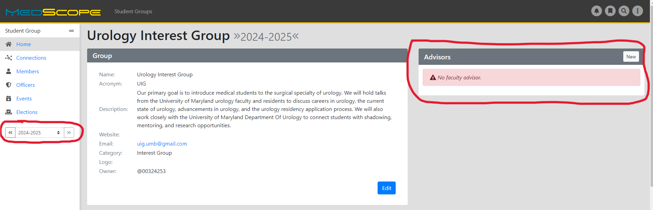

Slide 17
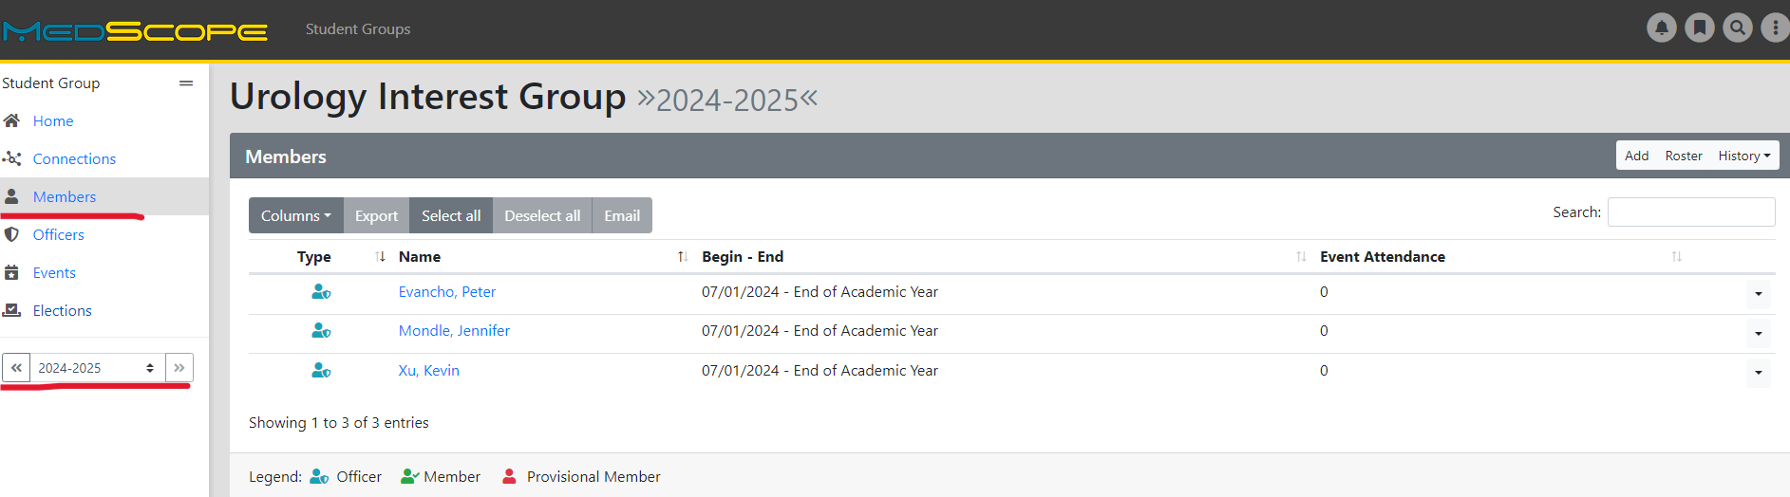

Slide 18
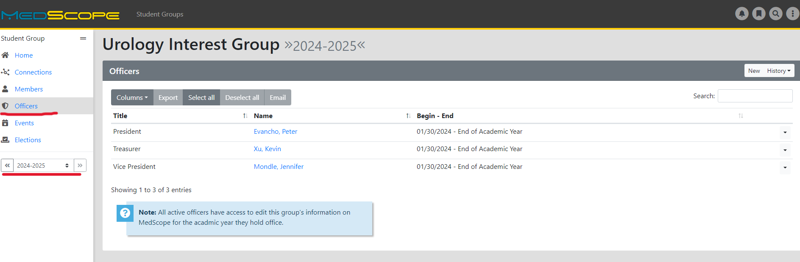

Slide 19
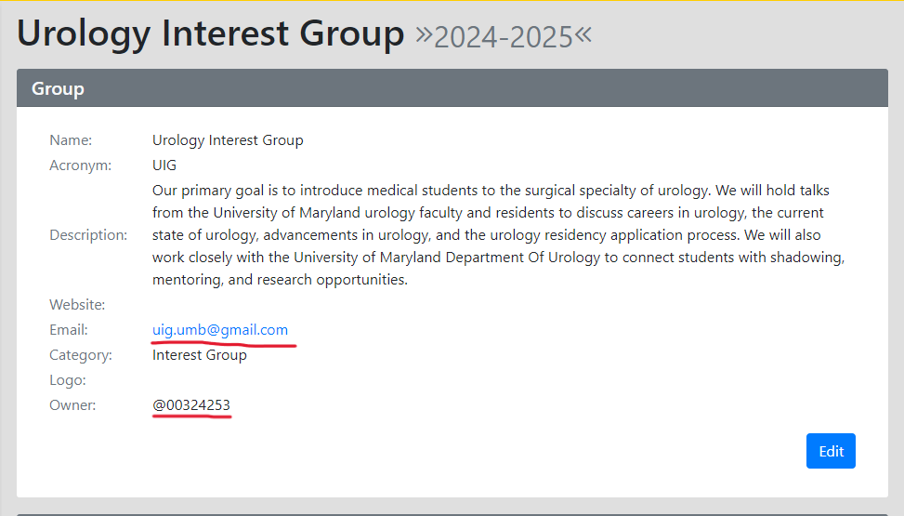
Keep email and description updated
“Owner” will be group President or one of current officers

Slide 20
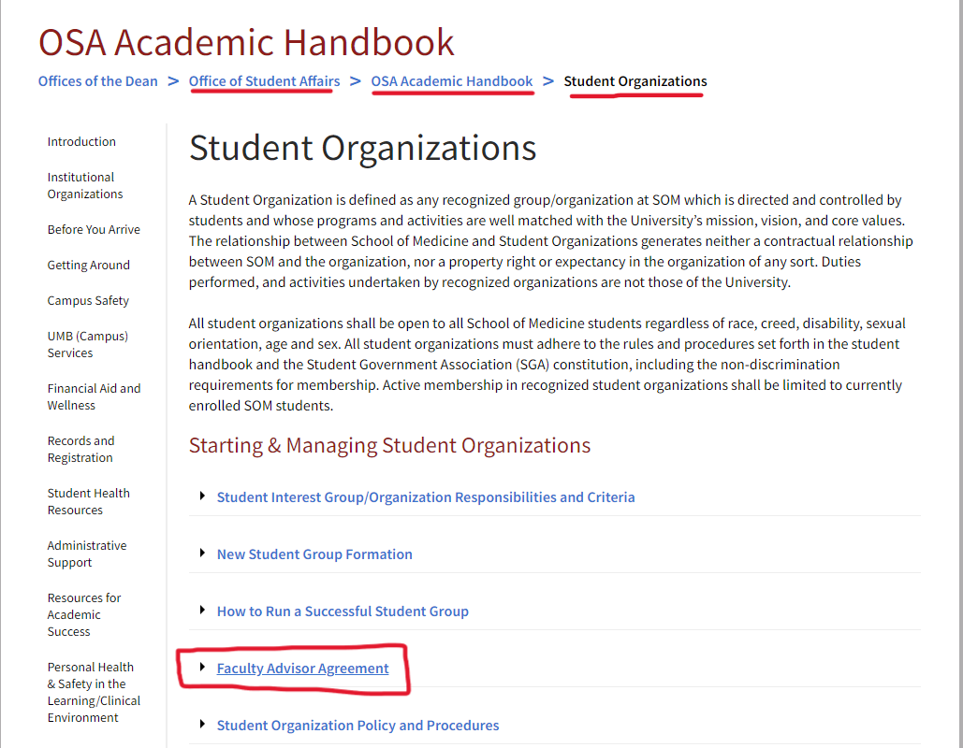
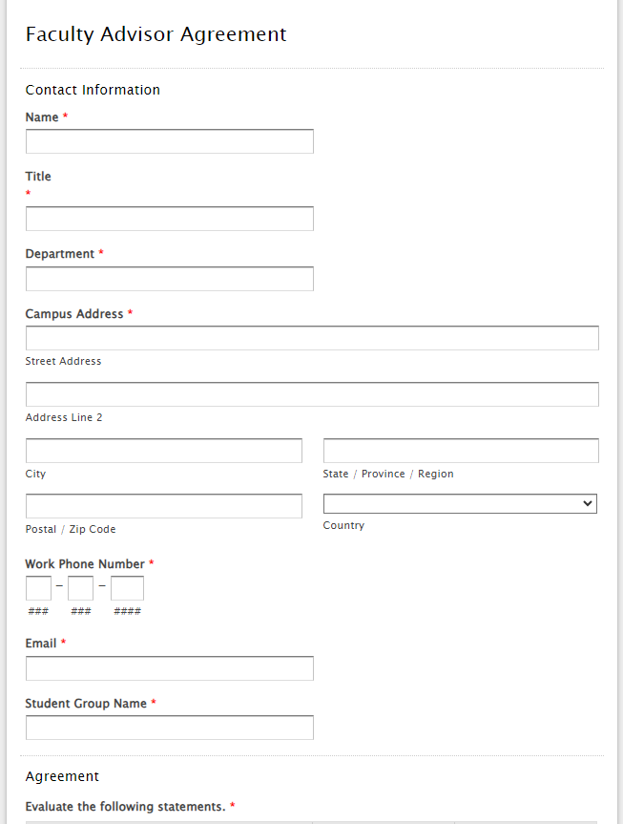
FACULTY ADVISOR FORM

Slide 21
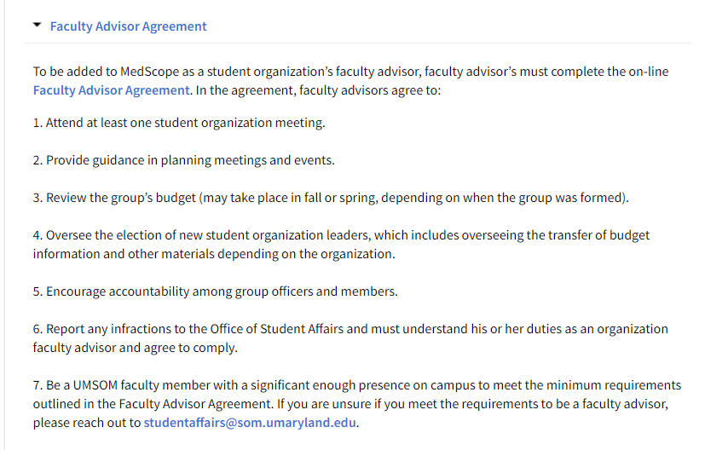
FACULTY ADVISOR OVERVIEW

Slide 22
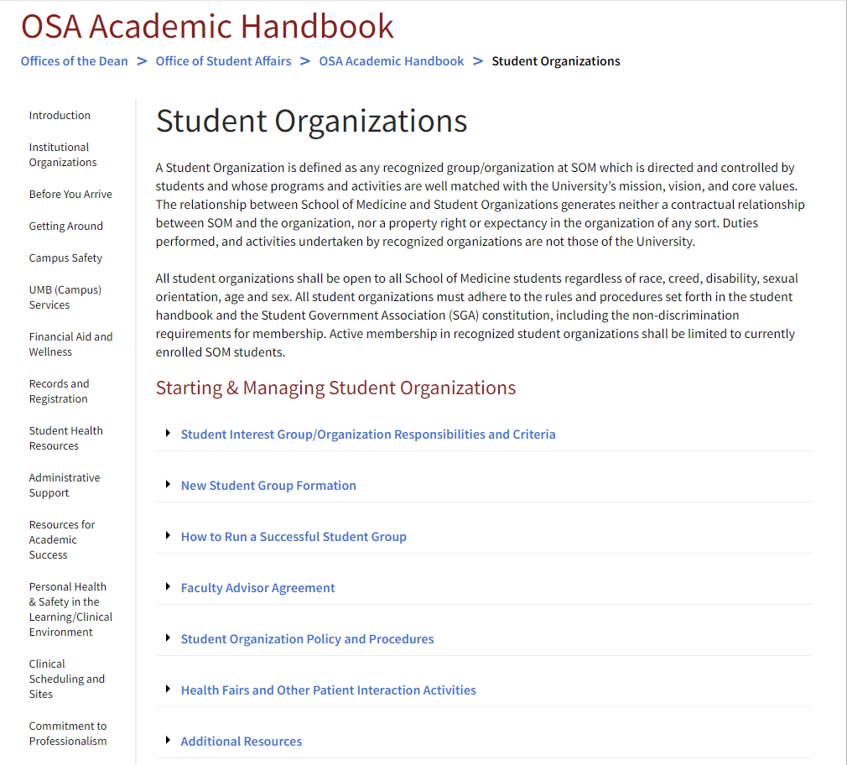
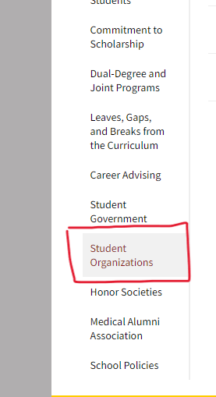
Student Organizations Overview

Slide 23
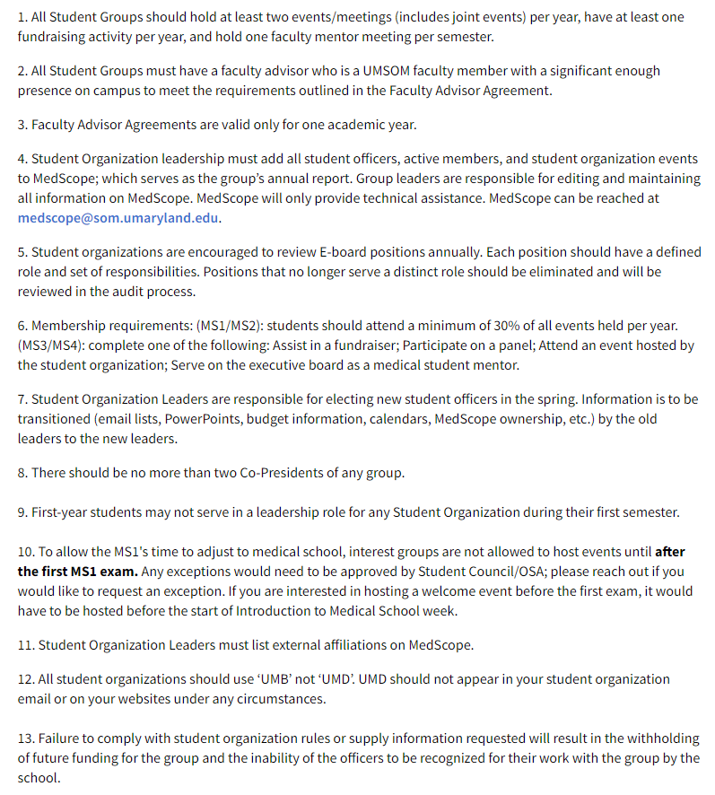
Student Group Responsibilities and Criteria
Full list found in the OSA Handbook
All Student Groups must have a faculty advisor who is a UMSOM faculty member with a significant enough presence on campus to meet the requirements outlined in the Faculty Advisor Agreement.
Submit a Faculty Advisor Form to OSA
(Please submit by the end of March).
All Student Groups should hold at least two events/meetings (includes joint events) per year, have at least one fundraising activity per year, and hold one faculty mentor meeting per semester.
T-shirts, mugs, pens
Bake sales
Restaurant profit sharing
Charity run
December/January 2026: All student groups are responsible for electing new group leaders, transitioning information (email lists, ppts, budget information, calendars).
Notes:
Faculty advisor must be a full time faculty of the school

Slide 24
STUDENT ORGANIZATION STORAGE
(MSTF Atrium Room H)
Each student group gets access to the OSA student storage room (MSTF Atrium Room H)
Sign-out keys for the storage room are located in OSA (cannot keep them).
Please no food to be stored in the room
Keep it organized.
  Please pick up after your group and try your best to organize
Clean it out at the end of each semester and during the transition to the next year’s group officers, keep inventory/let them know on what is being stored in the room.
Please be selective with what is stored in the storage room, as there is limited space.

Slide 25
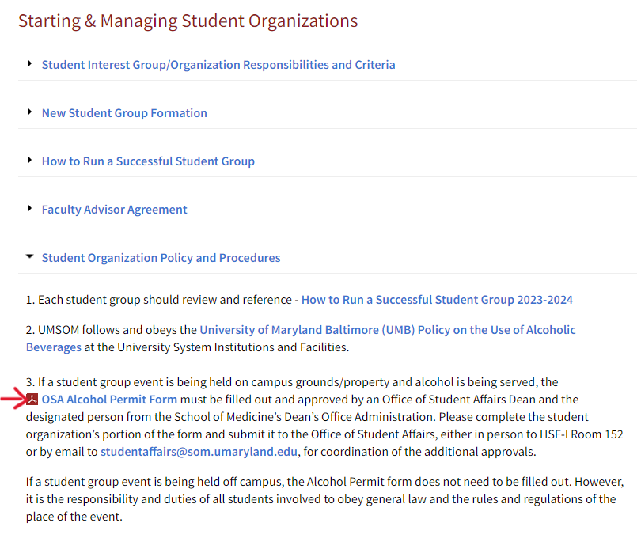
ALCOHOL FORM/POLICY
Notes:
PLEASE keep a copy of the permit and post it during your event so police won't shut you down.

Slide 26

WHAT ABOUT ALCOHOL?
The form only needs to be completed if the event is being held on campus grounds/property, otherwise the group should obey general law and the rules and regulations of the place of the event.
The UMB Alcohol Policy can be found on pages 2 and 3 of the Alcohol Packet. Please review it!
After you fill out the form and submit it, and if approved, you will receive a copy back for yourself/your group.
Student Groups can be reimbursed for alcohol purchases.
  However, student groups are not allowed to request funding from Student Council for alcohol purchases.
Keep a copy of your approved permit and POST it somewhere on a wall during your event.
  If you notice inappropriate behavior, take action according to the policy!

Slide 27
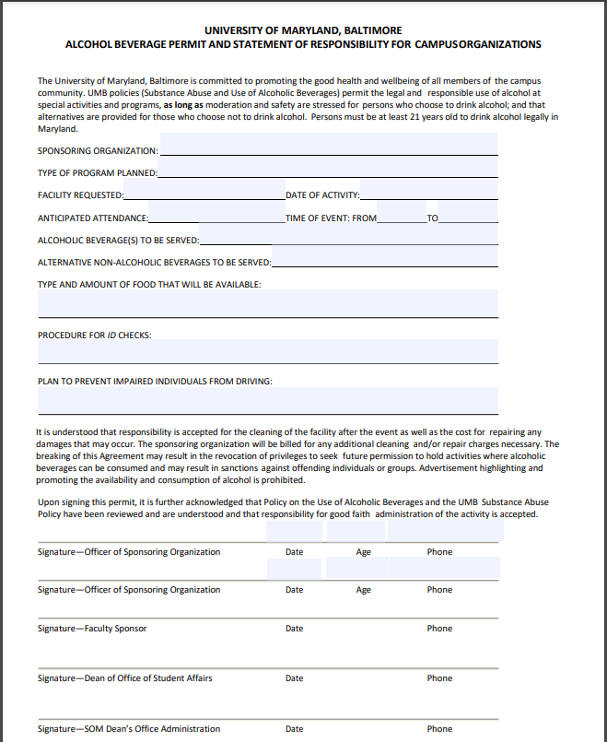
When downloaded, the alcohol permit is fillable. The top half of the first page is to be completed by the sponsoring organization. Drop off or send over to Adam Esselman in OSA RM 154 and he will submit for approval and send the group/person a copy for their records.

Slide 28
TABLES AND CHAIRS REQUEST/FACILITIES REQUEST
Reach out to Adam Esselman (aesselman@som.umaryland.edu) in OSA if you need a table for your event
For smaller requests (i.e. bake sale, fundraising tabling, etc.), Adam will work with the CSS team (Ronnie) in obtaining a folding table to use outside the Reid Rooms or lecture halls
If you need tables and/or chairs for a larger event, *Please reach out at least three weeks in advance of your event, as the request to facilities must be submitted at least 14 days prior to the event. Adam/OSA must submit the facilities request for the group.
*Chair and table renting from facilities has a fee
Facilities will bill for the labor needed to set up and break down the furniture, and there is no pricing specific to types of furniture. Available are – stacking chairs, 3x6’ rectangular tables and 5’-diameter round tables. They do not provide table linens.

Slide 29
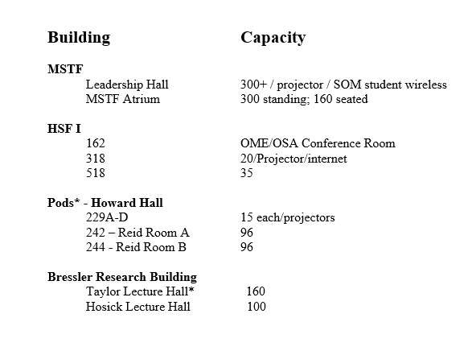
ROOM Reservations
Check MedScope for other events to minimize overlap
Room Reservation:
rooms@som.umaryland.edu
To reserve AV equipment
    av@som.umaryland.edu
    css@som.umaryland.edu
Remember: Food events cannot be held in Leadership Hall, Taylor or Hosick Lecture Halls.

Slide 30
CAMPUS
Other Rooms Available on Campus can be found at https://www.umaryland.edu/university-life/rooms-available-on-campus/
SMC Campus Center
  https://www.umaryland.edu/campuscenter/host-an-event/
  eventservices@umaryland.edu
Davidge Hall, School of Dentistry, Nursing, SW, Law, HSHSL, Pharmacy, SMC, Lexington & Bio Park
(Other buildings may have different rules ex: alcohol, catering. We suggest asking about the rule when you make your reservation.)

Slide 31
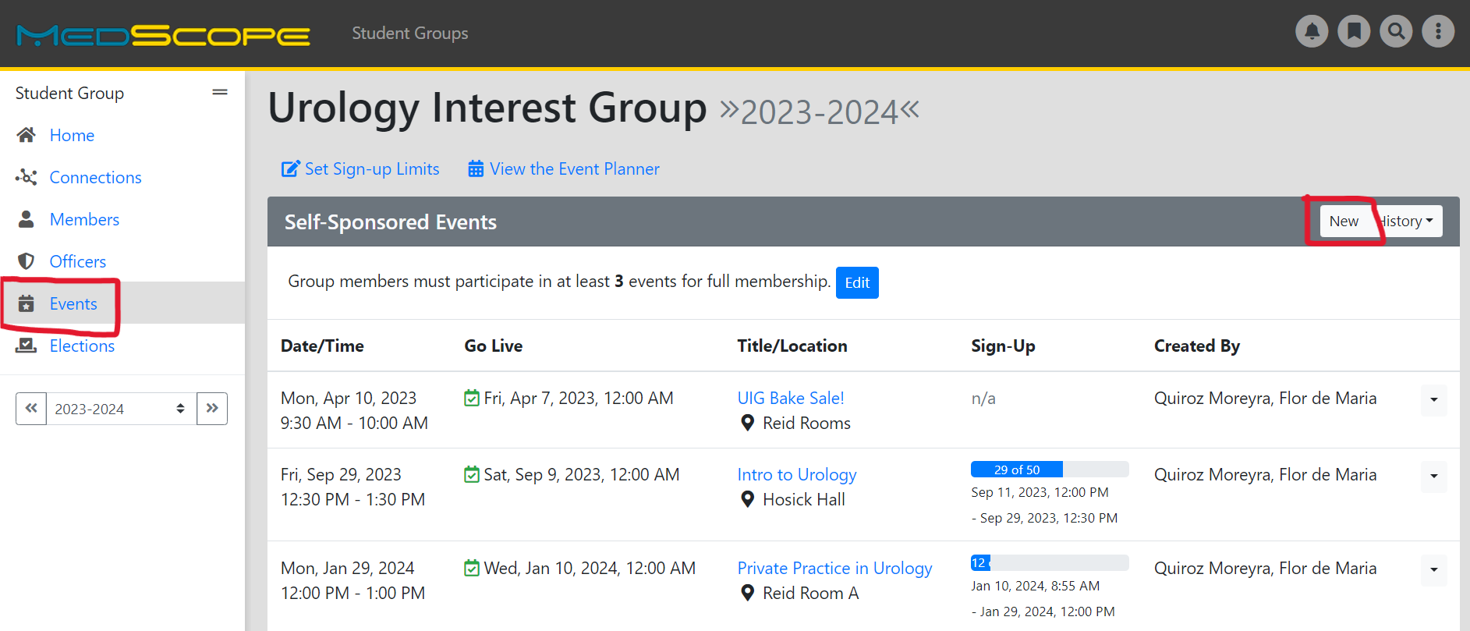
HOW TO ADD AN EVENT TO MEDSCOPE
Notes:
Council

Slide 32
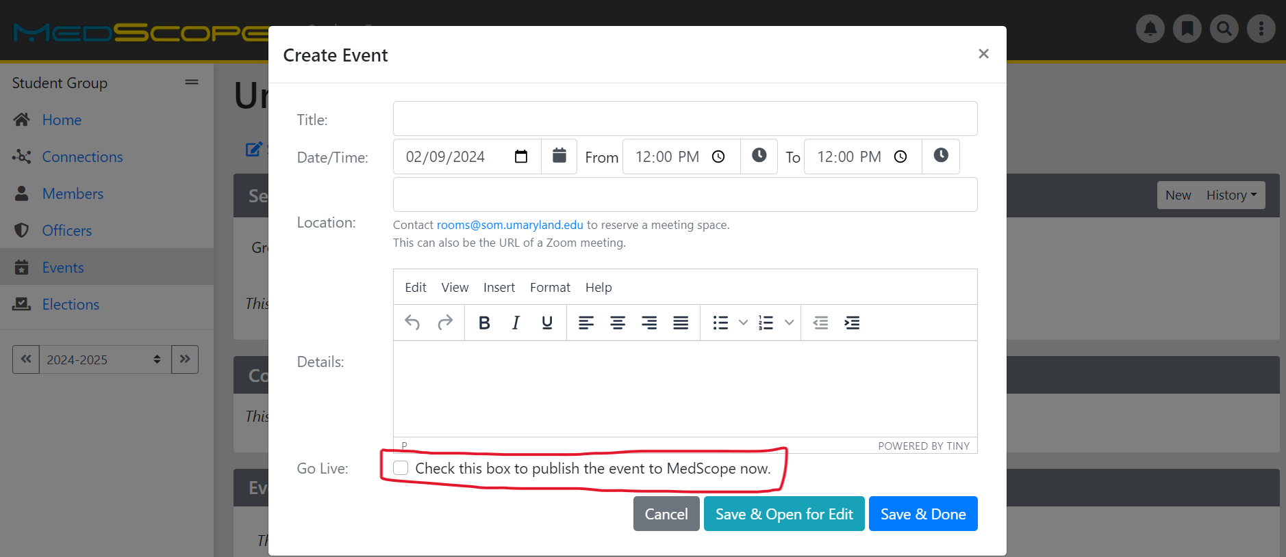
Notes:
Council

Slide 33
ATTENDANCE AND MEMBERSHIP
Groups should take attendance at every meeting using MedScope
  Helpful for funding requests
Members should attend at least 3 events
  Can update and keep track of attendance on MedScope
Keep your membership lists active on MedScope
Need AV/PPT? Contact Audio Visual team (CSS@som.umaryland.edu) 1-2 days before the event
Notes:
Council

Slide 34
Student Group Accounting

Slide 35
BANK ACCOUNTS
Adam Esselman (OSA) has all your accounting information and current balances
  Room 154 in the OSA office (Suite 150)
  Your group Gmail account (and group President and/or Treasurer) will receive balance account updates periodically.
    If you ever want to know your current balance or see a list of recent account transactions, please reach out to Mr. Esselman.

Slide 36
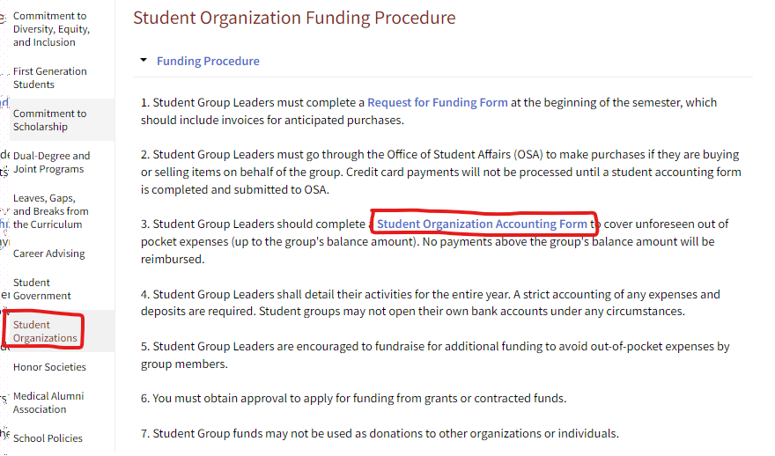
STUDENT ORGANIZATION ACCOUNTING FORM

Slide 37
STUDENT ORGANIZATION
ACCOUNTING FORM
Group members should complete an accounting form in order to:
  Use money from your account
  Cover unforeseen out of pocket expenses (up to the group’s balance amount). No payments above the group’s balance amount will be reimbursed.
  Request a reimbursement
  Make deposits into your account (fundraisers/donations) – Checks can be made out to the specific UMSOM Student Group or UMSOM Student Council
  Request a direct payment via credit card
REMINDER:
The payee and the approving e-mail cannot be the same on the student accounting form!
*A reminder that the approver needs to submit a form as well (will get an email sent to them after the
accounting form is submitted)

Slide 38
STUDENT ORGANIZATION ACCOUNTING FORM, CONTD.
ADVICE/TIPS:
Complete this on time/ ahead of time for every event
If a group member does not want to pay out of pocket, OSA (Adam Esselman) has a student group credit card. As long as you give him an invoice and a student accounting form, he could pay for expenses directly from your group account; must be completed at least 2 days in advance
If you need an updated student group account balance, please email Adam Esselman at aesselman@som.umaryland.edu
SAVE YOUR RECEIPT
Groups are encouraged to fundraise to avoid out of pocket expenses by group members
Please keep to larger purchases
Can combine costs and one person submit for reimbursement

Slide 39
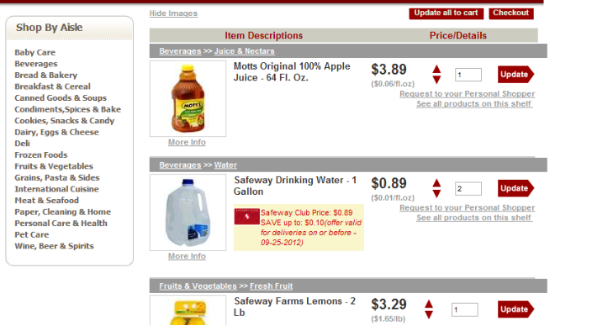
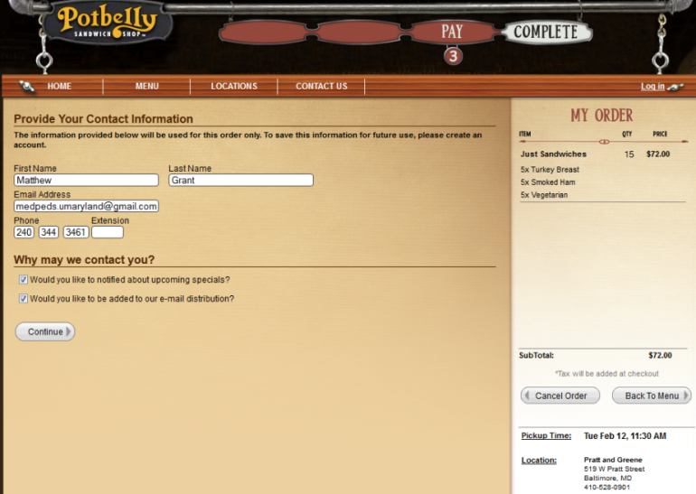
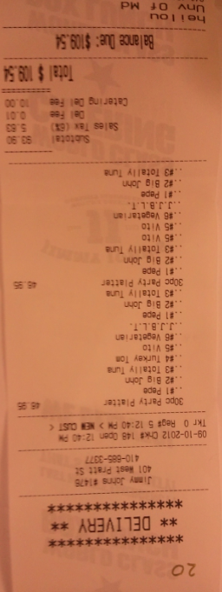
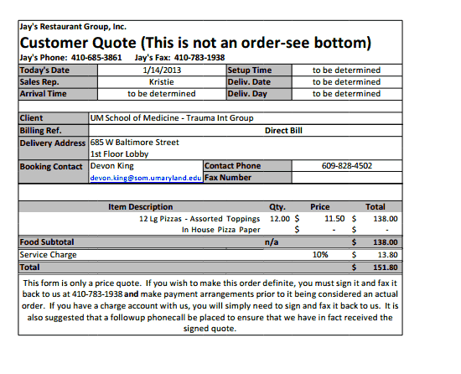
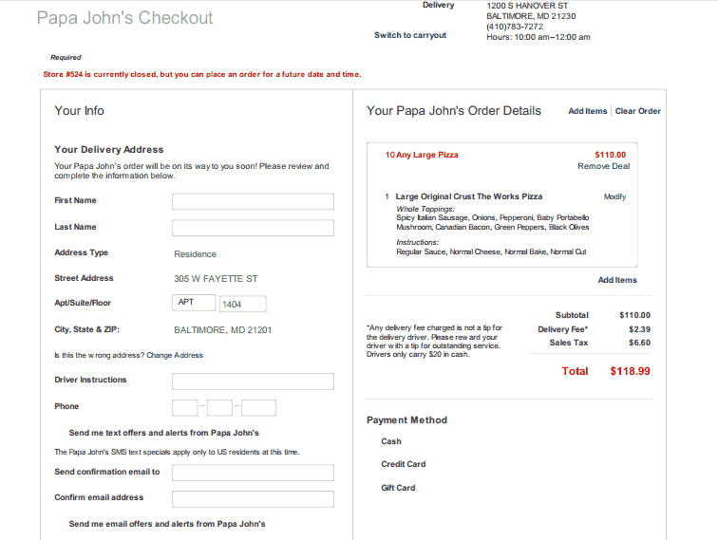
EXAMPLES OF RECEIPTS

Slide 40
TAX EXEMPT
We do have a tax exempt code that can be used for student group purchases
Any business should offer you tax-free prices with the tax exempt form.
Tax exempt form will be provided upon request (only used for larger purchases/contracts).

Slide 41
FUNDRAISING FOR STUDENT GROUPS
OSA does have the ability to create a website for your fundraising through Weebly.
Any Fundraiser using a School of Medicine or Maryland logo or imaging MUST be approved by the UMB Marketing team prior to going live.
Weebly can collect credit card payments and any order information you may need. (Ex: size, color, etc.)
When you are ready to start a fundraiser webpage, please fill out this form and reach out to Adam Esselman (aesselman@som.umaryland.edu)

Slide 42
Student Council
Sabrina Nusraty – PRESIDENT
Delara Rajabi – VICE PRESIDENT
Bobby McLuckey – TREASURER
Ruchika Gadagkar – SECRETARY

Slide 43
FUNDING REQUEST FROM STUDENT COUNCIL!
We have only $5,500 to split amongst the 65+ student groups per semester.
Please DO NOT over request. Your fund request may not be fully allocated, depending on amount requested and timing of upcoming scheduled events.
Due Dates:
Spring: TBA (end of February/beginning of March)
Fall: TBA (approximately the middle of September)
The form will open in both the spring and the fall, and you are allowed to submit for each open period.
Notes:
Council – Look at OME/School Calendar re: above dates

Slide 44
FUNDING CRITERION
Attendance
Group Longevity
Fundraising
Requested Funds
Planned Events
Notes:
Council

Slide 45
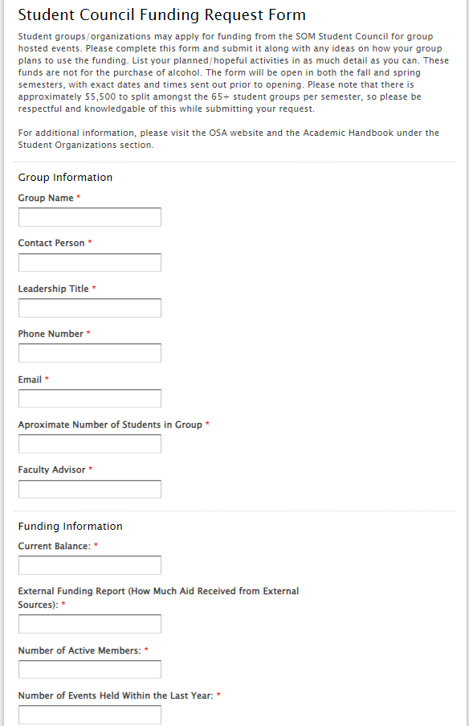
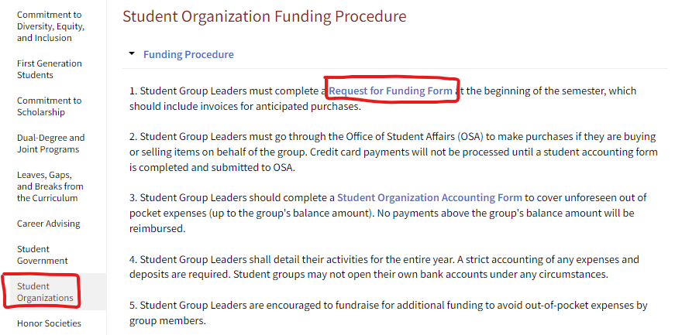
Student Council Funding Form

Slide 46
STUDENT GROUP ACTIVITES
Notes:
Council

Slide 47
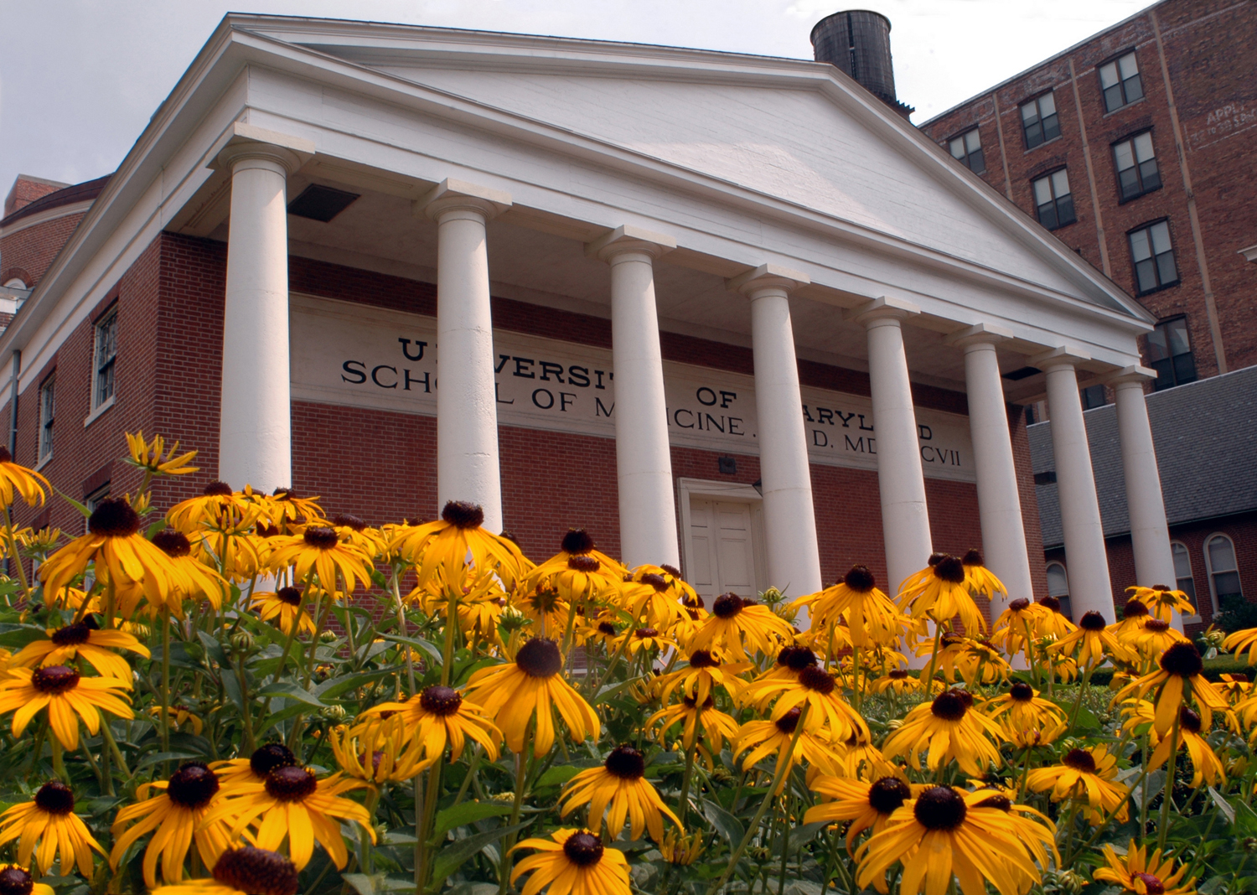
STUDENT LEADERS MEETINGS
Student Leaders Meetings run from September – April. Every month OSA will be inviting students that are not in the Class Government or in a Student Council to Student Leader’s Meetings.

Slide 48
IMPORTANT DATES SUMMARY
February/March
  Spring funding request
February/March
  Faculty Advisor Form due
August/September
  Student Activities Fair
September
  Fall funding request
December/January (following year)
  Elect new officer positions and transition from M2 to M1 leadership
Notes:
Council – Will need to be updated

Slide 49

PAST FUN EVENTS HOSTED BY STUDENT COUNCIL…
March Madness Dodgeball
Inner Harbor Cruise
Trivia
Cookouts
Talent Show
Camden Pub Karaoke Night
Have Ideas? Email Us!
Notes:
Council

Slide 50
CONTACTS
Dr. Kerri Thom, Associate Dean for Student Affairs
  kthom@som.umaryland.edu
Adam Esselman, Senior Academic Services Specialist
  aesselman@som.umaryland.edu
Kevin Brown, Assistant Dean for Undergraduate Medical Education Operations
  kbrown@som.umaryland.edu
Kristen McCartin, Events Specialist
  kmccartin@som.umaryland.edu
Student Council
  umb.som.council@gmail.com

