Slide 1
Extramural Rotations
“The Away”
Information for Students Considering doing an Away Rotation

Slide 2
Overview
Defining the extramural elective
OSA advising regarding extramural rotations
Applying through VSLO
Registering at UMSOM
The student perspective
Q&A
Notes:
Re: Student Health
Each current Grad student should have our immunization program CastleBranch (CB) and CB will notify them of any updates. If there is any doubt, they can call our office at 667-214-1883 and we will be glad to assist them. If anyone needs an updated PPD skin test or vaccines (including the Flu vaccine) they can come in on our Shot Times Schedule
Review average UMB loan debt, current and projected total graduation debt. Borrows will receive a tutorial of AAMC MedLoans calculator and a foundational review of repayment plans and best strategies. May also discuss third year expenses, scholarships and loan forgiveness opportunities that are available for the students.
They should all have a hospital badge unless they are dual degree students who are rejoining the MD program.
Tami will need to send the final clerkship schedules for each student to CJ Spann to have student hospital access modified accordingly.
We don’t do anything with fingerprinting , but I believe this is a required part of the VA onboarding.
All students need to redo Hipaa training (same training from 1st year).

Slide 3
The Extramural Elective – “Away Rotations”
An “Away” rotation is any course, not in the UMSOM course catalog, taken for credit at an external institution
Requires application to host school and registration at SOM
May be used toward SOM graduation requirements as one of the 5 required electives

Slide 4
Why do students participate in “Aways”?
Residency application requirement
Enhance competitiveness for a residency application
Student preference
  Visit a program/location of interest
  Participate in unique experience not offered here

Slide 5
Are “Away” Rotations Required?
Required for EM residency
  All SOM students applying to EM should do ONE EM away rotation
Strongly Consider for Child Neurology, PM&R
  Specialties with no home program
Recommended for …
  Dermatology, Neurosurgery, Ophthalmology, Orthopedic, Otolaryngology, Plastic Surgery, and Urology
Generally, not recommended for other specialties

Slide 6
Are “Away” Rotations Required?
May be considered for …
  Anesthesiology, OBGYN, Psychiatry, Surgery/General – although uncommon and may be challenging to get aways in these fields
  Interest in a specific program
  Interest in a specific geographic area (mostly outside of East Coast)

Slide 7
Away Rotations: Pros & Cons
Pros
Experience outside SOM
Enhance networking
Spend time in city
Cons
Cost
Travel/lodging
Month long interview
  Can be positive or negative
Outside safety of “home program”

Slide 8
Deciding where to apply
Program/location of interest (AMA Frieda Database)
Advice from specialty advisors
Discussion with OSA Dean
*Where our students Match https://medscope.umaryland.edu/thematch
*Recent external electives for SOM students (class page)
Calendars may not match – speak with OSA Dean

Slide 9
Securing your Away Rotation
Most schools/programs schedule their away rotations through VSLO (Visiting Student Learning Opportunities)
  You will receive authorization for VSLO in January
  All students must review a short module and attest to expected practices to gain access to VSLO
  UMSOM Contact: Bailey Jenkins
  Schools not participating in VSLO – follow instructions on webpages
Regardless, you MUST register with UMSOM to get credit!
  UMSOM Contact: Brian Wynder

Slide 10
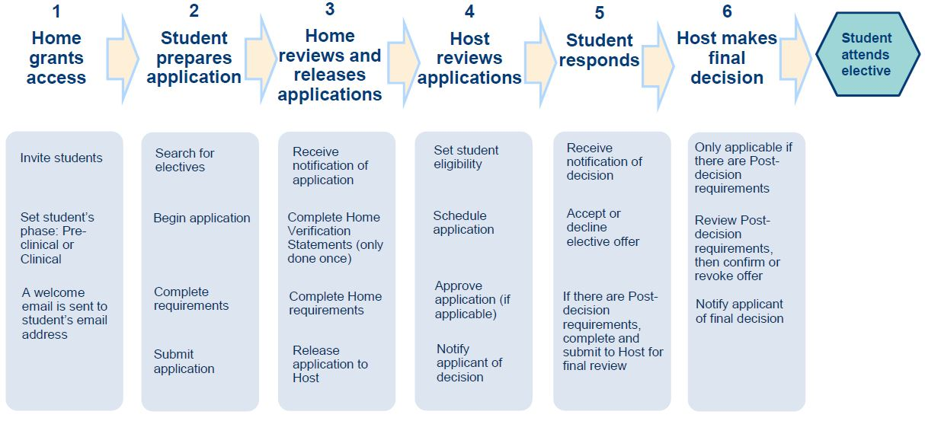
VSLO Process Flow
The VSLO program charges a flat fee of $15 per application. Application fees are per elective regardless of requested dates for that elective. Some institutions might have additional fees.
Notes:
STEPH
Overall process of VSLO. Every school is a little different in their timelines and how they accept students.
There are some things that us as the Home Institution have to do during this process and some things that you as the student need to do. Just be sure to communicate with us ASAP when the host institution indicates that they need things. Makes for a smoother process overall.
We are also checking VSLO daily and see things you might need but still communicate with us.
If you are really interested in a particular institution, I recommend reaching out to the VSLO contact at that school to see if they can give you any tips or updates on the process.
Applications fees are different per institution

Slide 11
Standard Requirements
CV
Personal Statement
USMLE Step 1 Score Report
Immunization Records
Headshot
Notes:
STEPH
- These are some items that could be asked about. Each institution is different on what they need. Be prepared that they could ask for any or these documents or even additional.
Please note, some items like the toxicology screening and criminal background check are not required for all. This is also a cost that you as the applicant must pay and be responsible for.
Start gathering this information NOW. Some of this might take a while for you to gather. Specifically, LOR’s. Begin asking for those NOW to give people plenty of time.

Slide 12
What other documents might you also need?
COVID-19 Vaccination Documentation
Mask Fit Test Documentation
HIPPA Training Certificate
Toxicology Screening
BLS/ACLS
Professional Liability and Malpractice Coverage
OSHA Certificate
Personal Health Insurance
Letter of Recommendation
Influenza Vaccine Documentation
Criminal Background Check
Notes:
STEPH
- These are some items that could be asked about. Each institution is different on what they need. Be prepared that they could ask for any or these documents or even additional.
Please note, some items like the toxicology screening and criminal background check are not required for all. This is also a cost that you as the applicant must pay and be responsible for.
Start gathering this information NOW. Some of this might take a while for you to gather. Specifically, LOR’s. Begin asking for those NOW to give people plenty of time.

Slide 13
What documents can OSA help with?
Mask Fit Documentation *
Letter of Good Standing *
HIPPA Training (Good Guy Letter) *
Bloodborne Pathogen/OSHA Training (Good Guy Letter) *
Professional Liability and Malpractice Coverage *
Transcript
Uploading Letters of Recommendation
Affiliation Agreements
* Submit a request for these items via the Away Rotation Document Request Form
Notes:
STEPH
Be sure to communicate with us during this time on what items you might need. There is more notice we have, the better!
Anything that is not on these lists that you have questions about, please reach out! Happy to help!

Slide 14
AAMC VSLO Student Webinar
This 75-minute webinar will address common questions about the away rotation process.
VSLO Webinar
https://students-residents.aamc.org/visiting-student-learning-opportunities/visiting-student-learning-opportunities-vslo
Notes:
STEPH

Slide 15
Registering at SOM
Yay! You’ve been accepted ☺
The next step is to register for the course at SOM
  Add/Drop Process
  Extramural Elective Form
  Requires departmental approval
  Confirmation of acceptance
  Academic Handbook – Extramural Rotations

Slide 16
Registering at SOM
THIS IS REALLY IMPORTANT
You MUST register with UMSOM before the rotation to get credit!
  UMSOM Contact: Brian Wynder
  IF YOU DO NOT REGISTER with UMSOM …
    You will NOT receive credit toward graduation
    It will NOT be on your transcript
    You are NOT covered for Malpractice insurance
    You WILL receive a professionalism citation, which may be noted on your MSPE

Slide 17
Procedures and Policies
All Advanced Clinical Phase rotations are 4 weeks in length
  Students may be allowed to participate in 3-week electives (in-catalog or out-of-catalog) when conflicts arise between academic calendars (requires at least 15 working days).
  Students may not receive graduation credit for 2-week rotations; cannot combine two 2-week rotations for credit.

Slide 18
Policies and Procedures
One Away Rotation (Elective of Sub-I) results in ONE SOM Elective credit toward graduation
Of the FIVE 4-week electives …
  At least TWO electives must be “on campus” (i.e., must be in the catalog)
Graduation Requirements

Slide 19
Next Steps
You will receive an email tomorrow morning from Ms. Jenkins
Residency Application Manual – Extramural Rotations
  Watch the “Extramural Rotation Registration Module”
  Attest that you have completed the module
  After above is complete, you will receive a token to access VSLO

Slide 20
The Student Panelists
Name | Specialty | Away Location | Best point of contact
Colin Scott | Gen Surg | Jefferson | 610-737-8781 Colin.scott@som.umaryland.edu
Cami Lingenfelter | Ortho | UPMC, Columbia, Allegheny General, Union Memorial | 240-997-1805 Cameron.lingenfelter@som.umaryland.edu
Puja Patel | EM | Cooper | 240-351-7290 Puja.patel@som.umaryland.edu
Fernando Martinez Guasch | Ophtho | NYU, Bascom Palmer Eye Institute/ U Miami | 857-707-9202 fmartinezguasch@som.umaryland.edu
Allison Karwoski | Plastics | Hopkins, Georgetown, Yale, Rush | 301-502-8133 akarwoski@som.umaryland.edu

Slide 21
Additional Contacts
Joe Blommer- Orthopedics (jblommer@som.umaryland.edu)
Danielle Sim- Plastic Surgery (dsim@som.umaryland.edu)
Gurbani Singh- Radiation Oncology (gurbani.singh@som.umaryland.edu)
Daniel Shats- Urology (dshats@som.umaryland.edu)
Donald De Alwis- Anesthesia (ddealwis@som.umaryland.edu)
Jenny Strong- Dermatology (jastrong@som.umaryland.edu)
Pharibe Pope- ENT (pharibepope@som.umaryland.edu)
Radhika Gholap- Ophthalmology (rgholap@som.umaryland.edu)
Tony Koshar- Orthopedics (antoan.koshar@som.umaryland.edu)

Slide 22
Questions
How did you decide what programs to apply to for away rotations/ what strategies did you use to figure out where to apply?
What was the timeline of when you applied to away rotations? When did you start browsing on VSLO and applying?
How many away rotations should you apply to?
What is the optimal timing for doing away rotations (before vs. after ERAS, before vs. after Sub-Is at home)?
What are the parts of the application?
How did you figure out living/ housing logistics for your away?
What advice would you provide on how to excel during your away rotation?
Should you meet with the away physician and/or director before departing your rotation to get feedback, ask for a letter of rec, and/ or determine application potential?

